Slide 1
CHESS REMEETS THE MACHINE
Under aesthetic conditions...

Slide 2
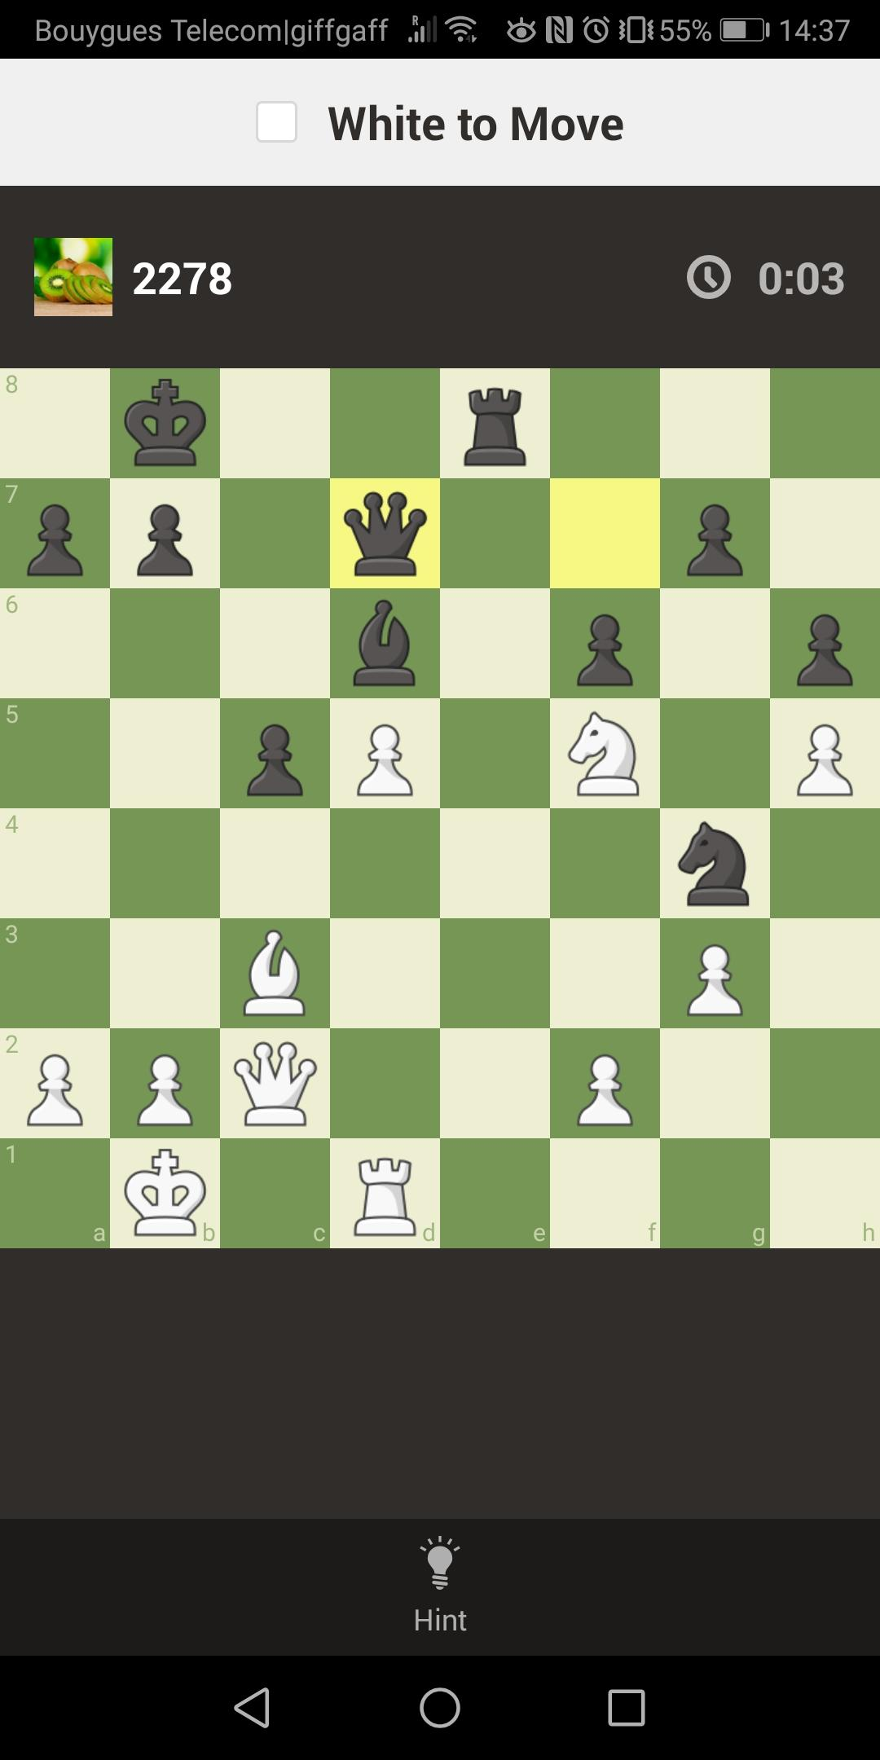
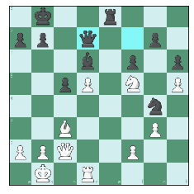
PROJECT CONCEPT:
[ ]
[
[
[
[
[
[
[
[
]====> 1k2r3/
]====> pp1q2p1/
]====> 3b1p1p/
]====> 2pP1N1P/
]====> 6n1/
]====> 2B3P1/
]====> PPQ2P2/
]====> 1K1R4
FEN (Forsyth-Edwards-Notation) of image position:
1k2r3/pp1q2p1/3b1p1p/2pP1N1P/6n1/2B3P1/PPQ2P2/1K1R4

Slide 3
A brief break down of
the FEN:
CHARACTER NOTATION
P - white pawn, | p - black pawn,
N - white knight, | n - black knight,
R - white rook, | r - black rook,
B - white bishop, | b - black bishop,
K - white king, | k - black king,
Q - white queen | q - black queen
/ - new row
Number from 1 to 8 - number of empty squares between pieces and or rows
Taking the example from the last slide:
1k2r3/pp1q2p1/3b1p1p/2pP1N1P/6n1/2B3P1/PPQ2P2/1K1R4
(Reading from the top left to bottom right of the board.)
[
[
[
[
[
[
[
[
]====> 1k2r3/
]====> pp1q2p1/
]====> 3b1p1p/
]====> 2pP1N1P/
]====> 6n1/
]====> 2B3P1/
]====> PPQ2P2/
]====> 1K1R4
Notes:
p - black pawn,
n - black knight,
r - black rook,
b - black bishop,
k - black king,
q - black queen
Piece Notation:
P - white pawn,
N - white knight,
R - white rook,
B - white bishop,
K - white king,
Q - white queen

Slide 4
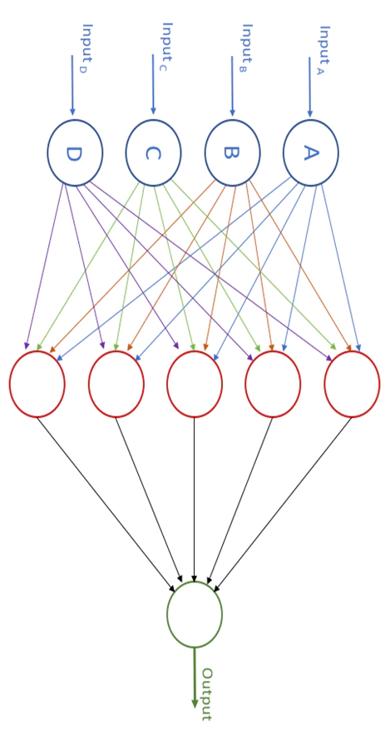
A simple Neural Network
A neuron is a function of everything in the past layer. Let’s look at an example with Neuron E.
The Weighted SUM of neuron E: The sum of all inputs multiplied by their individual weights towards neuron E (W_{iE} = a number), all added to the bias of neuron E (b_{E} = another number).
We then feed this weighted SUM into an activation function to give an output proportional to the magnitude of its weighted SUM.
Weighted SUM of E = (A*W_{AE}) + (B*W_{BE}) + (C*W_{CE}) + (D*W_{DE}) + Bias of neuron E
Neuron E output = Activation_fn(Weighted SUM of E)
Note: the activation function does not change from neuron to neuron
We repeat for neurons F -> I, giving our 5 outputs from the second layer. We can then calculate the output neuron in the final layer using neurons E -> I as inputs.
From the amount of difference between our output and the target (real value) we are aiming for, we calculate the ‘loss’ and alter the weights and biases accordingly in order to lower this ‘loss’ for next time.
W_{DE}
W_{CE}
W_{BE}
W_{AE}
E
F
G
H
I
A((𝜮w_{iE}) + b_{E})

Slide 5
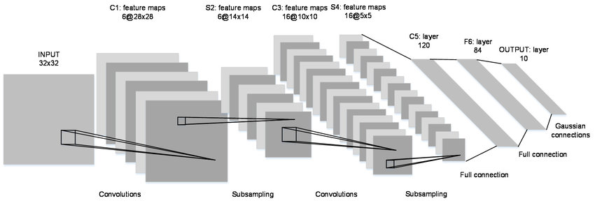
CNN - Convolutional Neural Networks
CNN’s also are made from neurons, however they are specialised for images. They focus their attention on parts of the image, recreating their own smaller images, extracting only the key features from the sections they are looking at within the past layer.
This ‘convolution’/ ’extraction’ allows for faster computation than the regular Neural Network as each neuron is only connected to part of the last layer.
As images are, in essence, data heavy objects with key features in grouped areas of the image, CNNs yields incredible results fast!

Slide 6
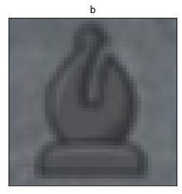
CNN applied to chess images:
Cutting the board from the screenshot, it was then further cut into its 64 squares, with its piece notation (target) alongside each square. The CNN then reiterates the process explained regarding loss, over many many images, this is its training process.
Prediction: P
Real value: b
Loss = difference
Propagates backwards to alter weights and biases of neurons in each layer
Black bishop: b

Slide 7
MY FIRST HURDLE
I started trying a CNN on a grayscale image of board. Unfortunately the accuracy of this model flattened out around 8 predictions correct out of 10. Most of its trouble was detecting between black and white.
I decided to split this problem into 2:
Piece detection
Color detection
The addition of these 2 models will throw back the FEN of the board

Slide 8
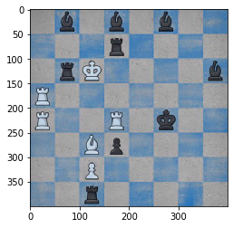
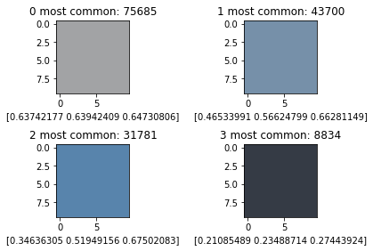
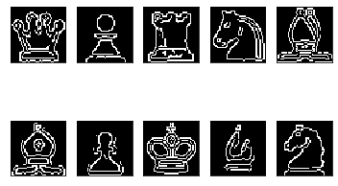
My two models:
COLOR DETECTION: K-MEANS CLUSTERING
I used K-means to see the most used colors in the image. I then created a model that would differentiate pieces from the board (by erasing the commonist board colours) and rerun a k-means to get the individual color of the pieces.
Unfortunately, the pieces and squares varied too much in colour, shading and texture! Never letting me get higher than 40% in a 3 target model i.e. 7% greater than random.
PIECE DETECTION: EDGES
Using open-cv’s canny edge detection algorithm I managed to get a binary representation of the pieces. The CNN model looked very promising, with ~99% accuracy on piece prediction.

Slide 9
BACK TO SQUARE 1
Going back to my original CNN model, tweaking it a bit, whilst feeding it coloured squares, gave the following results.
Predicting 2 pieces wrong on every 10,000.

Slide 10
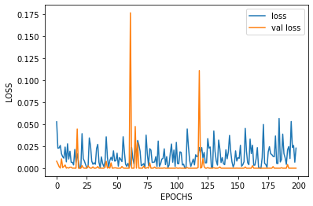
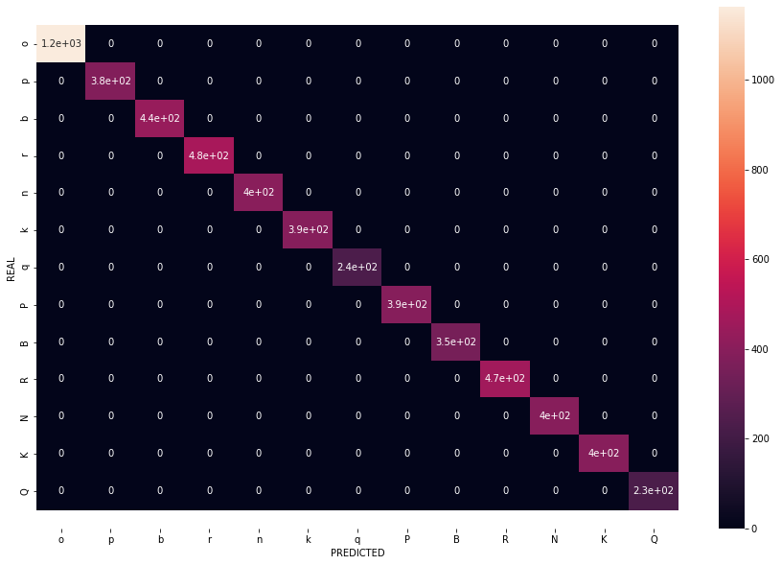
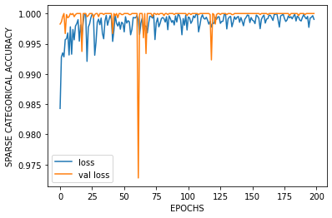
MODEL RESULTS:

Slide 11
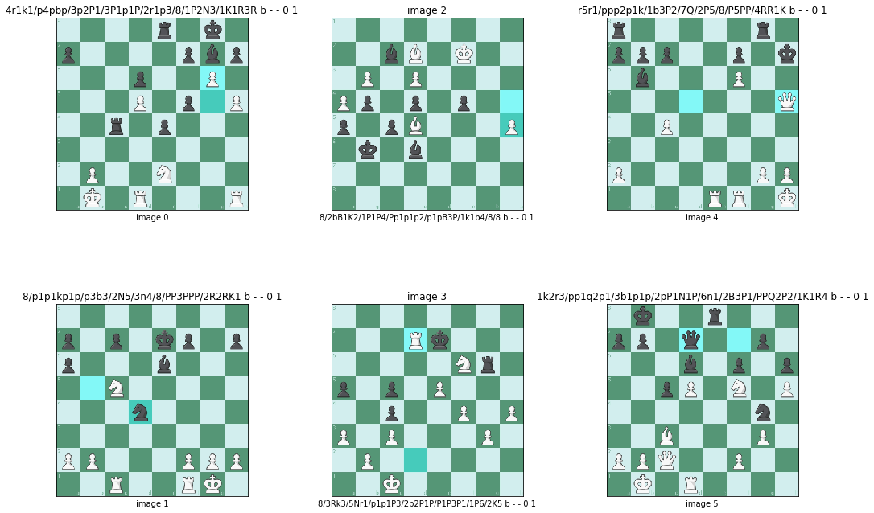

Slide 12


Slide 13
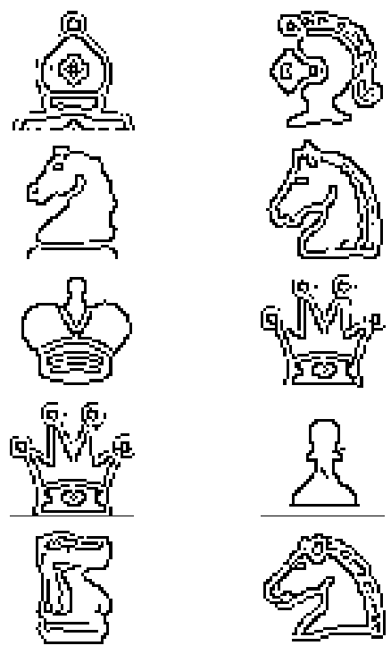

Beautiful edges
I was left with all these beautiful outlines.
I needed a way to generate them.
Ones never seen by the world before.
The idea of creating a Generative Adversarial Network (GAN) came to mind…

Slide 14
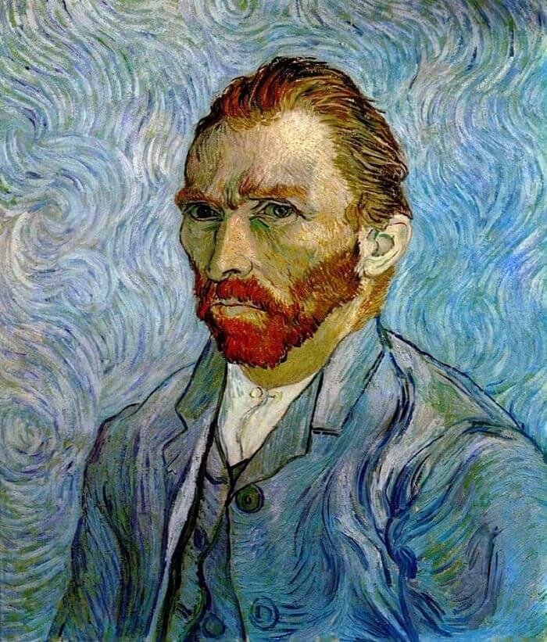
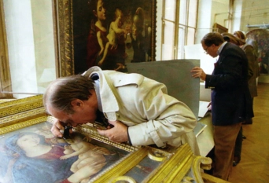
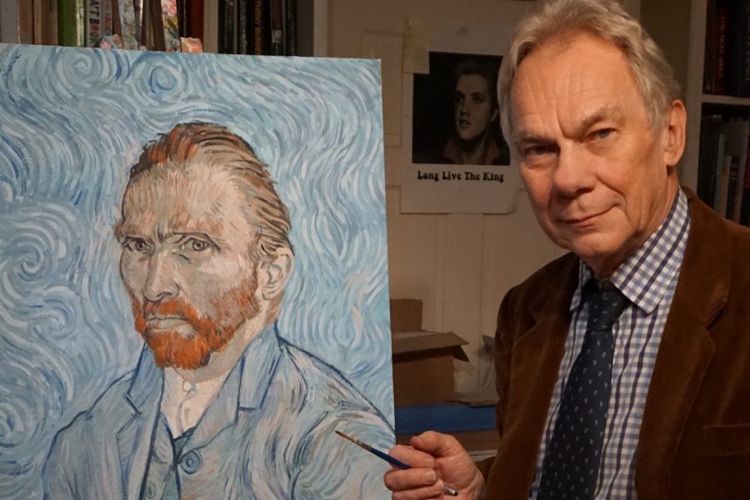
Generative Adversarial Network - GAN
You have many different Real images (piece outlines):
You have a CNN model acting as an authenticator:
You have a CNN model acting as a forger:
The forger is minimizing the probability of the authenticator differentiating between his work and the ‘Real’.
The authenticator is maximizing his odds of making the right differentiation.

Slide 15
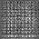
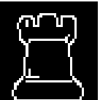
GAN’S
It’s Real!
It’s Fake!
AUTHENTICATOR
The only communication is the authenticator passing back his notes (‘probability of Fake/ Real’) to the forger after the forger has shown it the image.
The forger, starting from random noise, manages to create an image indistinguishable from real. Without ever seeing a ‘Real’ image…
...Machine Magic!
loss:
P(REAL)
REAL
FORGER

Slide 17
Transfer learning: Style Transfer
Nothing quite matters like ascetics. Especially when there isn’t much left to change in the relatively unchanged game of chess! I wanted to be able to recreate the position chosen in a personal ‘computerised’ way.
By using Imagenets pretrained vgg CNN image recognition model. I unblock and customised a few layers for it to look at, either, the ‘content’ of my board, or the features/ style of the image I want to merge into the ‘content’.

Slide 18
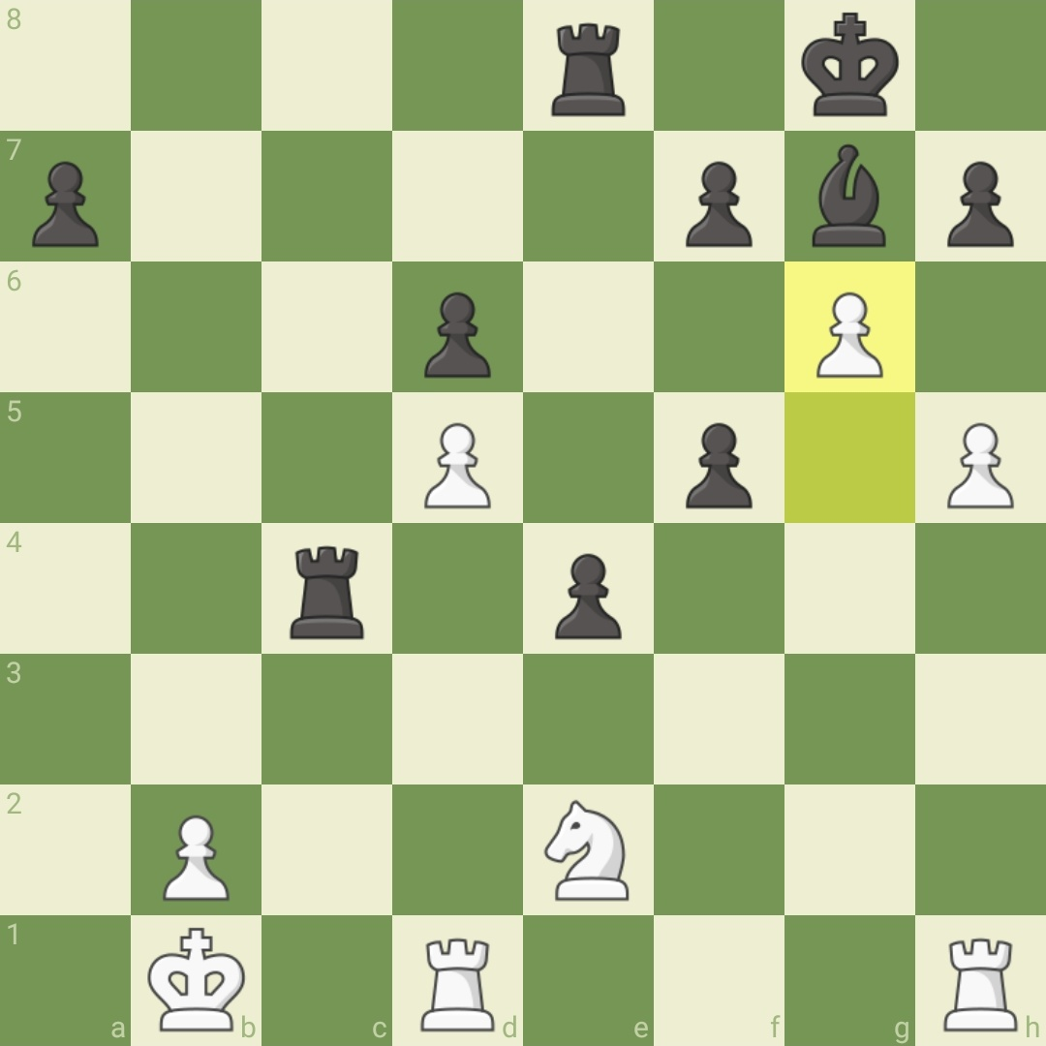
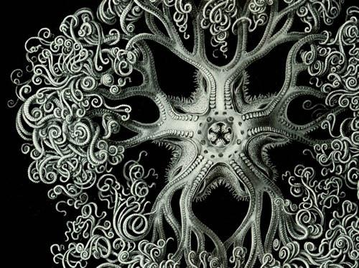

Slide 19
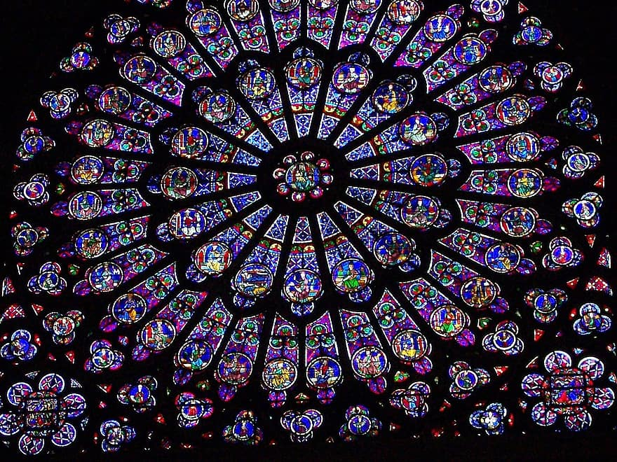

Slide 20
With more time: CHESS FUNKIFICATION
I intend to:
* Be able to extract FEN from photographs of a board
* Create a chess playing platform
* To be able to use the board of your choosing using Style Transfer
* To be able to use GAN generated pieces on your board
* Using the extracted FEN to get back to your position on the new board

Slide 21
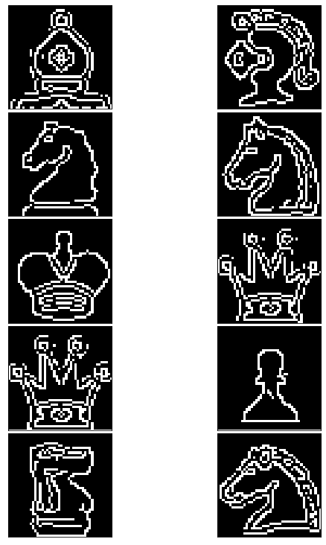
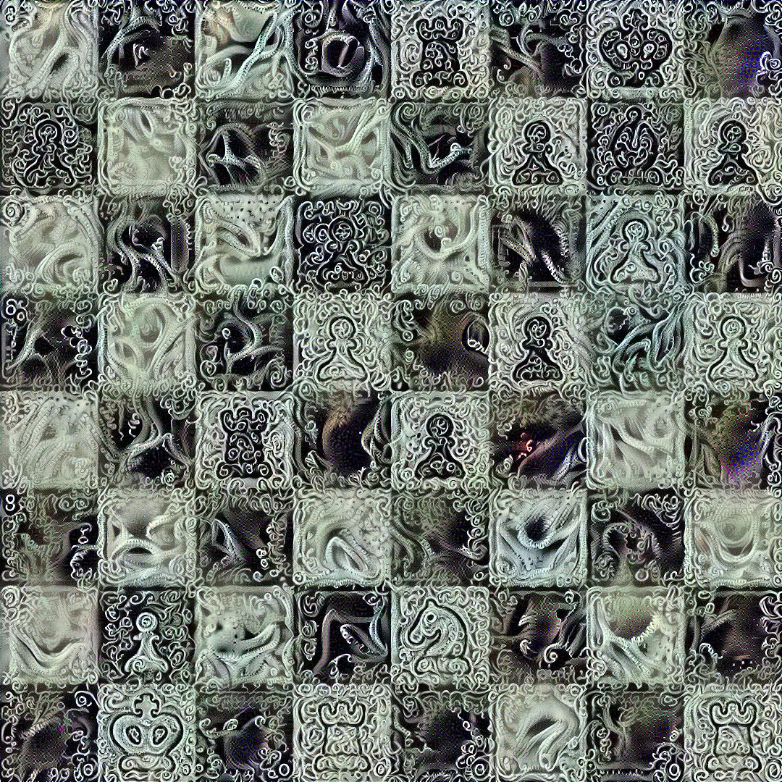
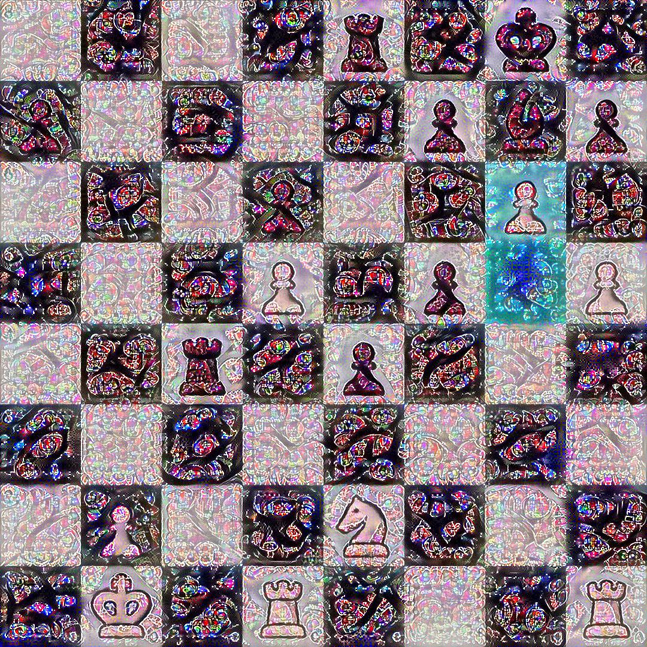
THANK YOU FOR LISTENING

